Slide 1
An Introduction to Particle Physics
by Eva A. Horvath
© Copyright 2017 Text-only by Eva A. Horvath

Slide 2
Topics
Positrons, pions, and muons introduced
Methods of detecting sub-atomic particles
Sources of sub-atomic particles
Particle accelerators
Discovery of Higgs-like boson in 2012
Mediators
Leptons and hadrons (baryons and mesons)
Strangeness
Quarks and the Eightfold way
Standard Model

Slide 3
What is the universe made of?
Particle physicists seek to answer this question by studying sub-atomic particles and their interactions. This field is concerned with understanding the smallest things.
By studying sub-atomic particles, insight into the nature of the universe can be gained.

Slide 4
Familiar Sub-Atomic Particles
Electrons, e⁻: discovered in 1897 by J.J. Thompson
Protons, p: discovered in 1911 by Rutherford
Neutrons, n: discovered in 1930 by Bothe and Becker and christened in 1932 by Chadwick
Photons, γ: proposed by Einstein-building on Planck’s idea- to explain photoelectric effect
eV₀ = hf - φ

Slide 5
Familiar Sub-Atomic Particles Cont’d
Neutrinos, ν: proposed by Pauli and first detected in 1950s by Reines and Cowan. Originally believed to be massless, but actually have a very small mass

Slide 6
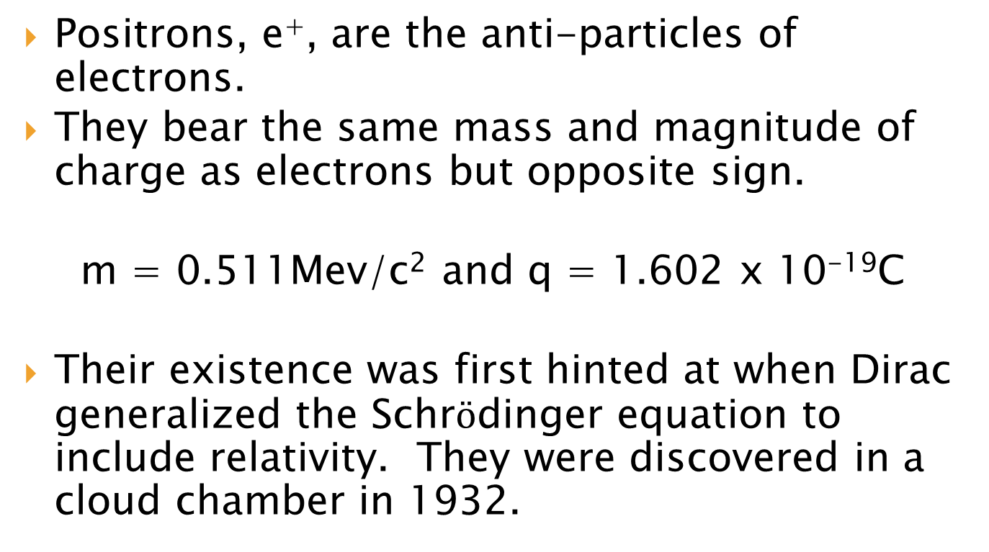
Positrons
Positrons, e⁺, are the anti-particles of electrons.
They bear the same mass and magnitude of charge as electrons but opposite sign.
m = 0.511Mev/c² and q = 1.602 x 10⁻¹⁹C
Their existence was first hinted at when Dirac generalized the Schr$ö$dinger equation to include relativity. They were discovered in a cloud chamber in 1932.

Slide 7
How are elementary particles detected?
Geiger counters, cloud chambers, spark chambers, bubble chambers, photographic emulsions, Cerenkov counters, scintillators, wire chambers etc.
In cloud chambers and bubble chambers, charged particles ionize atoms as they travel through the chamber leaving behind droplets or bubbles.

Slide 8
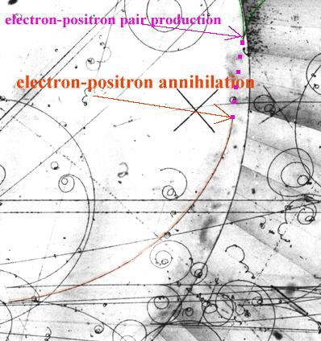
Positron-Electron Pairs
http://teachers.web.cern.ch/teachers/archiv/HST2002/Bubblech/mbitu/electron-positron.htm

Slide 9
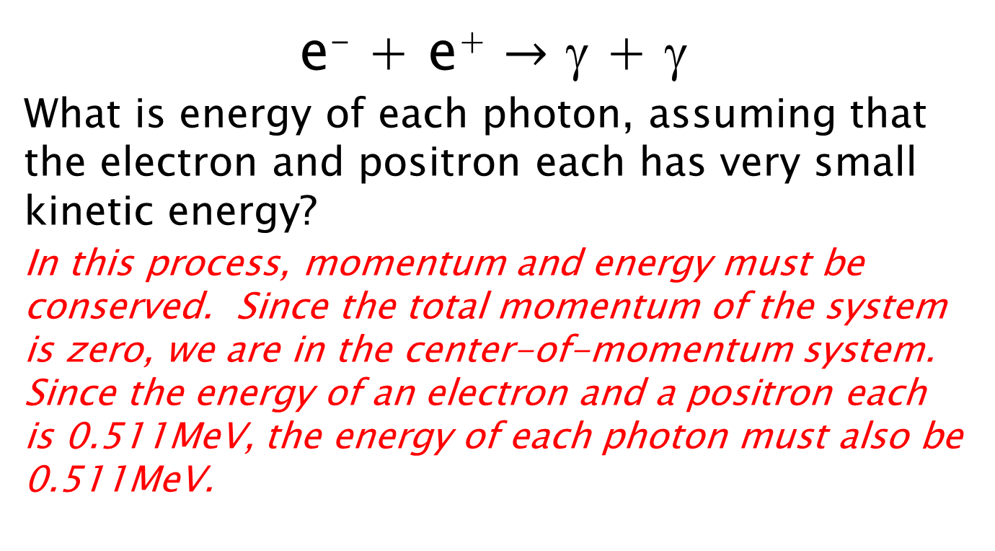
Electron-Positron Annihilation
e⁻ + e⁺ $→$ γ + γ
What is energy of each photon, assuming that the electron and positron each has very small kinetic energy?
In this process, momentum and energy must be conserved. Since the total momentum of the system is zero, we are in the center-of-momentum system. Since the energy of an electron and a positron each is 0.511MeV, the energy of each photon must also be 0.511MeV.

Slide 10
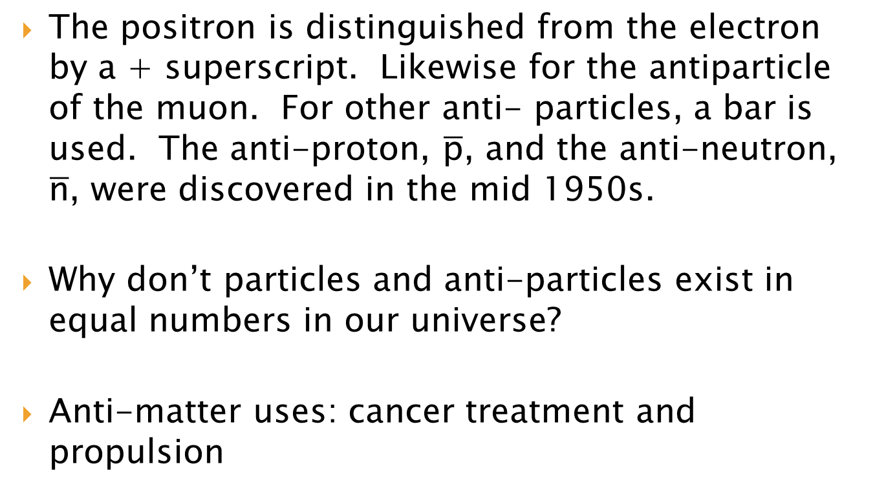
Anti-Matter
The positron is distinguished from the electron by a + superscript. Likewise for the antiparticle of the muon. For other anti- particles, a bar is used. The anti-proton, $\overline{\text{p}}$, and the anti-neutron, $\overline{\text{n}}$, were discovered in the mid 1950s.
Why don’t particles and anti-particles exist in equal numbers in our universe?
Anti-matter uses: cancer treatment and propulsion

Slide 11
Muons
Discovered in 1937 in cosmic radiation, originally thought to be pion predicted by Yukawa
Mass about 207 times that of an electron.
μ⁺ and μ – carry charges +e and –e, respectively.

Slide 12
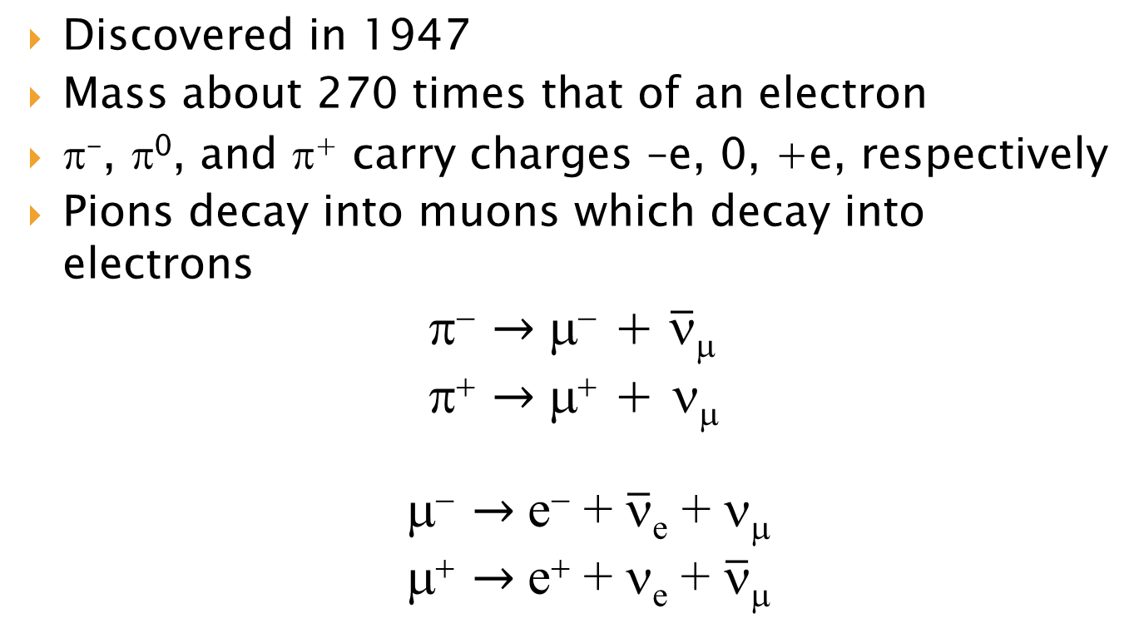
Pions
Discovered in 1947
Mass about 270 times that of an electron
π⁻, π⁰, and π⁺ carry charges –e, 0, +e, respectively
Pions decay into muons which decay into electrons
π⁻ $→$ μ⁻ + $\overline{\text{n}}$_{μ}
π⁺ $→$ μ⁺ + ν_{μ}
μ⁻ $→$ e⁻ + $\overline{\text{n}}$_{e} + ν_{μ}
μ⁺ $→$ e⁺ + ν_{e} + $\overline{\text{n}}$_{μ}

Slide 13
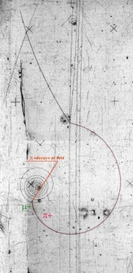
Decay of a Pion

Slide 14
Sources of Particles (Cosmic Rays)
Cosmic rays are particles that come from outer space; lowest energy cosmic rays come from the Sun. More difficult to determine the origin of higher-energy particles.
Disadvantage is that events are random and too infrequent.
Collisions with nuclei in upper atmosphere create pions which, in turn, decay into muons.
89% protons, 10% He nuclei, and 1% heavier nuclei of particles that interact with nuclei
1Gev to 10⁸Tev

Slide 15
Sources of Particles cont’d
Electrons and protons are easy to produce. Electrons can be produced by heating up metal and protons can be produced by ionizing hydrogen.
Naturally occurring radioactive elements
Nuclear reactors produce neutrons, neutrinos, alpha rays (⁴He nucleus), beta rays (β⁻ or β⁺), and gamma rays (γ).

Slide 16
Particle Accelerators
LINAC- Linear Accelerator
Cyclotron
Synchrotron
Particle accelerators enable scientists to produce nuclear reactions, create precisely controlled beams of particles, and probe the interior structure of other particles.

Slide 17
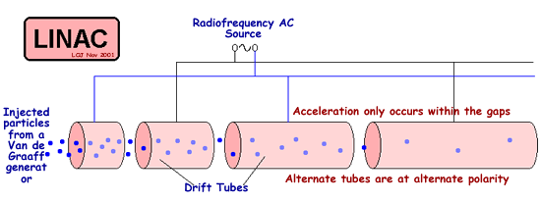
LINAC
http://www.cyberphysics.co.uk/topics/atomic/Accelerators/LINAC/Linac.htm

Slide 18
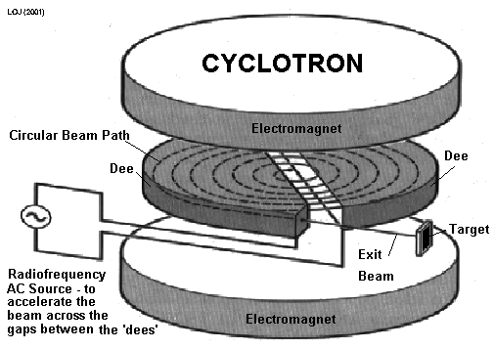
Cyclotron
http://www.cyberphysics.co.uk/topics/atomic/Accelerators/Cyclotron/Cyclotron%20.htm

Slide 19
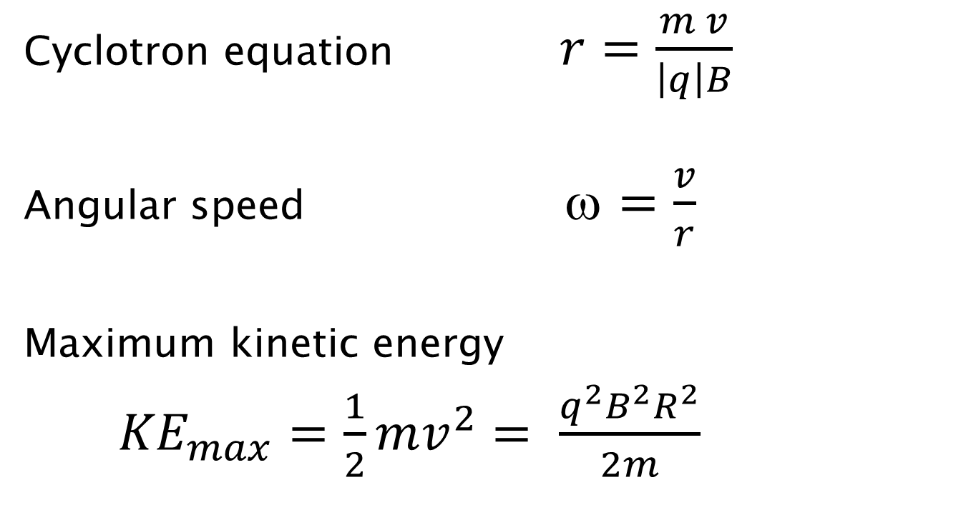
Cyclotron cont’d
Cyclotron equation $r=\frac{m v}{\left|q\right|B}$
Angular speed ω $=\frac{v}{r}$
Maximum kinetic energy
${KE}_{max}=\frac{1}{2}mv_{}^{2}$ $= \frac{q^{2}B^{2}R^{2}}{2m}$

Slide 20
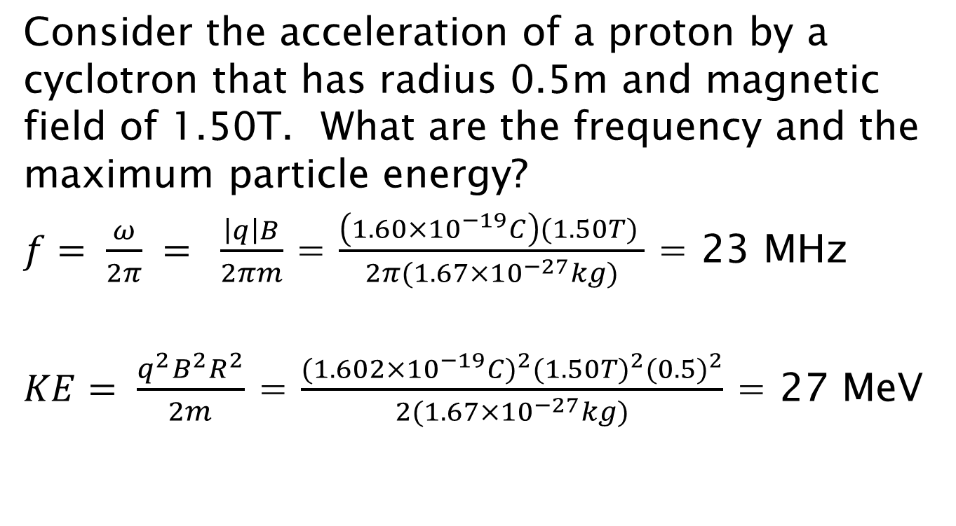
Cyclotron Example
Consider the acceleration of a proton by a cyclotron that has radius 0.5m and magnetic field of 1.50T. What are the frequency and the maximum particle energy?
$f= \frac{ω}{2π} = \frac{\left|q\right|B}{2πm}$ = $\frac{\left(1.60×{10}^{−19}C\right)(1.50T) }{2π(1.67×{10}^{−27}kg)}$ = 23 MHz
$KE= \frac{q^{2}B^{2}R^{2}}{2m}$ = $\frac{{(1.602×{10}^{−19}C)}^{2}{(1.50T)}^{2}{(0.5)}^{2}}{2(1.67×{10}^{−27}kg)}$ = 27 MeV

Slide 21
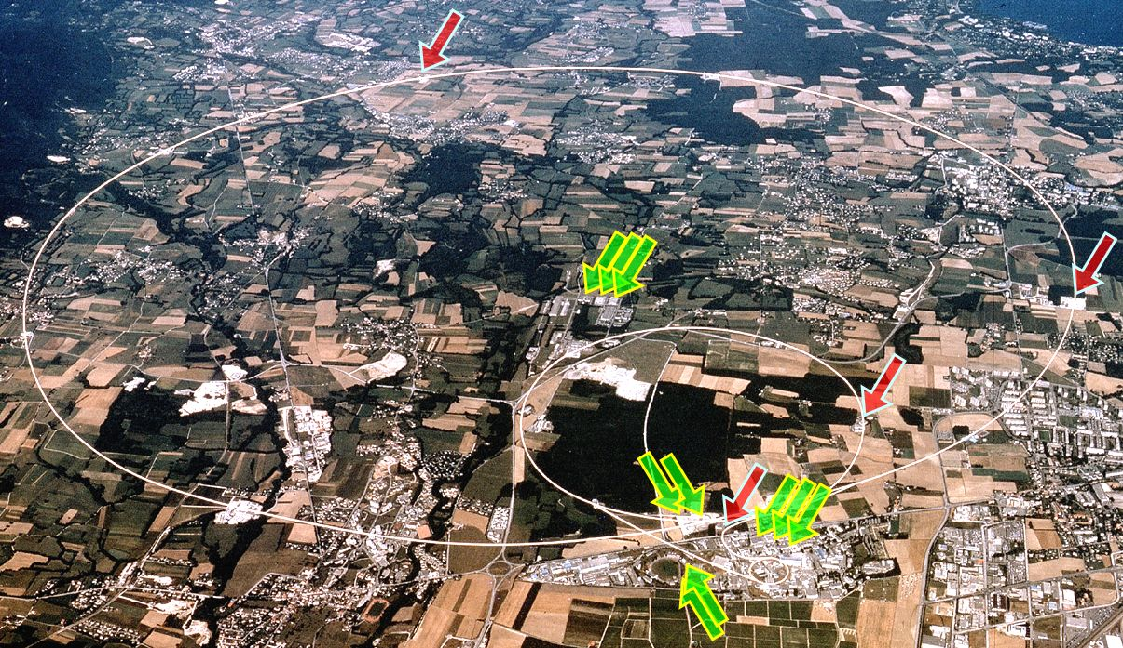
CERN Laboratory
http://supercond.web.cern.ch/supercond/

Slide 22
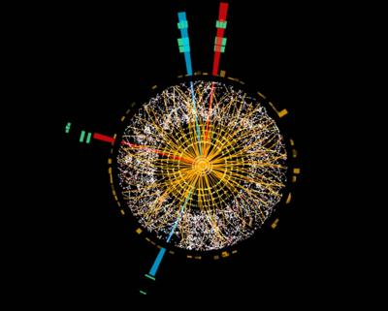
Discovery of Higgs-like Boson Announced July 4, 2012
The last missing piece to the Standard Model?
The
particle that confers mass on other particles?
Does particle have spin 0?
http://home.web.cern.ch/topics/higgs-boson

Slide 23
Available Energy
The available energy, E_{a} ,when a particle of mass m and total energy, E_{m}, bombards a target at rest that also has mass m
E_{a}² = 2mc²(E_{m} + mc²)
What must the total energy of α particles bombarding a stationary He target be if the available energy is 16GeV?
E_{m} = E_{a}² /2 mc² - mc²
⁼ (16GeV) ²/2(3.728GeV) – 3.728GeV = 30.6GeV

Slide 24
Colliding Beam
Consider a colliding beam experiment of like particles. If the colliding particles have momenta of equal magnitude and opposite direction, the total momentum is zero. In this case, the available energy is the total energy of the colliding particles.
In the previous example, each beam only needs to carry 8.0GeV.

Slide 25
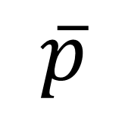
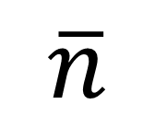
The Sub-atomic Zoo…
ν_{τ}
τ⁻
Λ⁰
$$\overline{p}$$
e⁻
π⁻
Σ⁺
Κ⁺
Ω⁻
μ⁺
ν_{e}
Ξ⁻
Ξ⁰
π⁰
p
e⁺
Σ⁻
n
Σ⁰
μ⁻
τ⁺
π⁺
ν_{μ}
η⁰
Κ⁻
$$\overline{n}$$
…and the need for classification

Slide 26
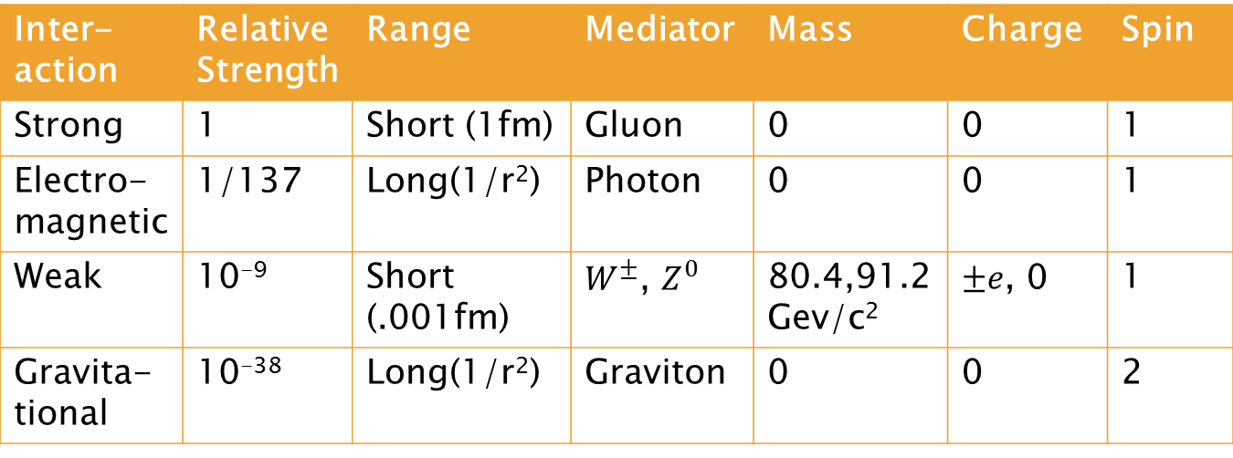
The Four Fundamental Interactions
Inter-action | Relative Strength | Range | Mediator | Mass | Charge | Spin
Strong | 1 | Short (1fm) | Gluon | 0 | 0 | 1
Electro-magnetic | 1/137 | Long(1/r²) | Photon | 0 | 0 | 1
Weak | 10⁻⁹ | Short (.001fm) | $W^{±}$, $Z^{0}$ | 80.4,91.2Gev/c² | $±e$, 0 | 1
Gravita-tional | 10⁻³⁸ | Long(1/r²) | Graviton | 0 | 0 | 2

Slide 27
Leptons and Hadrons
Original classification scheme by mass
Leptons, “light ones”
Mesons, “intermediate ones”
Baryons, “heavy ones”
Present classification scheme by interaction
Leptons don’t have strong interactions
Hadrons (comprised of mesons and baryons) do have strong interactions

Slide 28
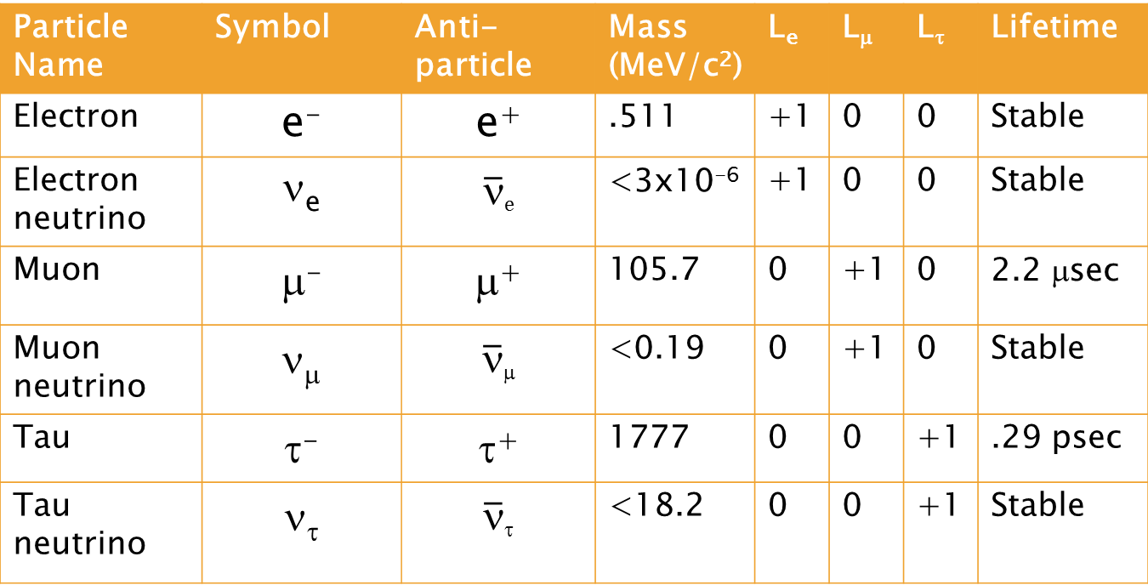
Leptons
Particle Name | Symbol | Anti-particle | Mass (MeV/c²) | L_{e} | L_{μ} | L_{τ} | Lifetime
Electron | e⁻ | e⁺ | .511 | +1 | 0 | 0 | Stable
Electron neutrino | ν_{e} | $\overline{\text{n}}$_{e} | <3x10⁻⁶ | +1 | 0 | 0 | Stable
Muon | μ⁻ | μ⁺ | 105.7 | 0 | +1 | 0 | 2.2 μsec
Muon neutrino | ν_{μ} | $\overline{\text{n}}$_{μ} | <0.19 | 0 | +1 | 0 | Stable
Tau | τ⁻ | τ⁺ | 1777 | 0 | 0 | +1 | .29 psec
Tau neutrino | ν_{τ} | $\overline{\text{n}}$_{τ} | <18.2 | 0 | 0 | +1 | Stable

Slide 29
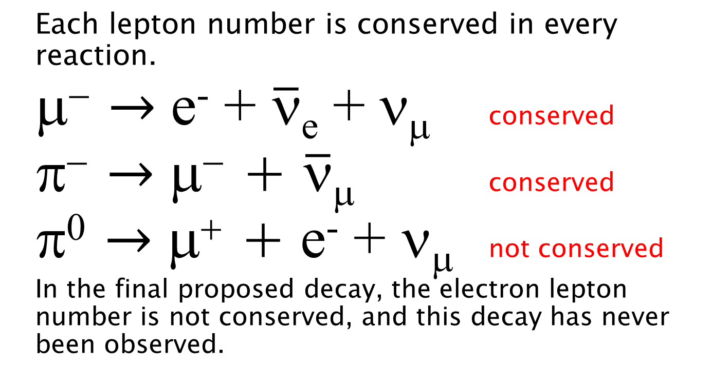
Conservation of Lepton Number
Each lepton number is conserved in every reaction.
μ⁻ $→$ e⁻ + $\overline{\text{n}}$_{e} +$\text{n}$_{μ} conserved
π⁻ $→$ μ⁻ + $\overline{\text{n}}$_{μ} conserved
π⁰ $→$ μ⁺ + e⁻ + ν_{μ} not conserved
In the final proposed decay, the electron lepton number is not conserved, and this decay has never been observed.

Slide 30
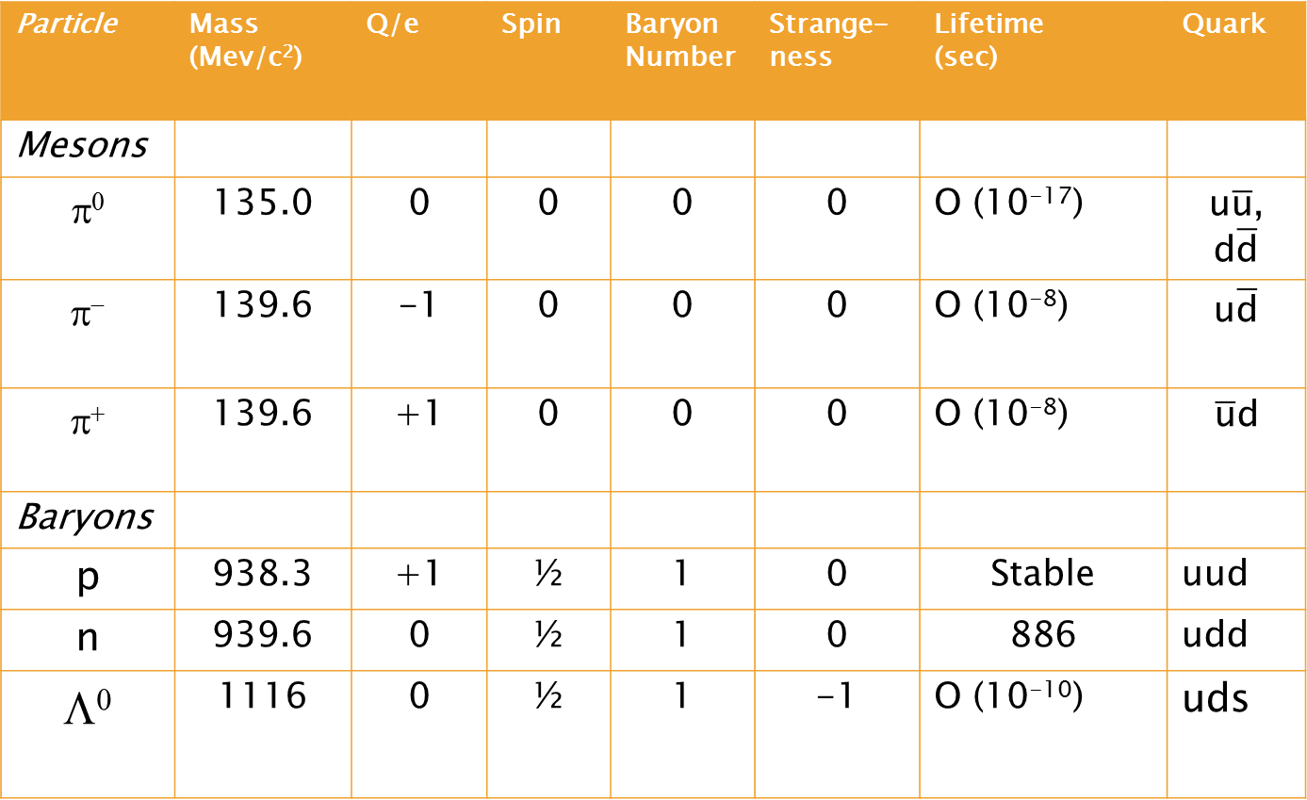
A Few Selected Hadrons
Particle | Mass (Mev/c²) | Q/e | Spin | Baryon Number | Strange-ness | Lifetime (sec) | Quark
Mesons
π⁰ | 135.0 | 0 | 0 | 0 | 0 | O (10⁻¹⁷) | u$\overline{\text{u}}$, d$\overline{\text{d}}$
π⁻ | 139.6 | -1 | 0 | 0 | 0 | O (10⁻⁸) | u$\overline{\text{d}}$
π⁺ | 139.6 | +1 | 0 | 0 | 0 | O (10⁻⁸) | $$\overline{\text{u}}\text{d}$$
Baryons
p | 938.3 | +1 | ½ | 1 | 0 | Stable | uud
n | 939.6 | 0 | ½ | 1 | 0 | 886 | udd
Λ⁰ | 1116 | 0 | ½ | 1 | -1 | O (10⁻¹⁰) | uds

Slide 31
A Few Observations about Hadrons
There are no stable mesons.
The only stable baryon is the proton.
Mesons are bosons and baryons are fermions.
Hadrons are composite particles.
Baryons are assigned B=+1 and antibaryons are assigned B=-1. Baryon number is conserved in each reaction.
There are more than 100 known hadrons, including K mesons and the hyperons, Λ, Σ, Ξ, Ω.

Slide 32
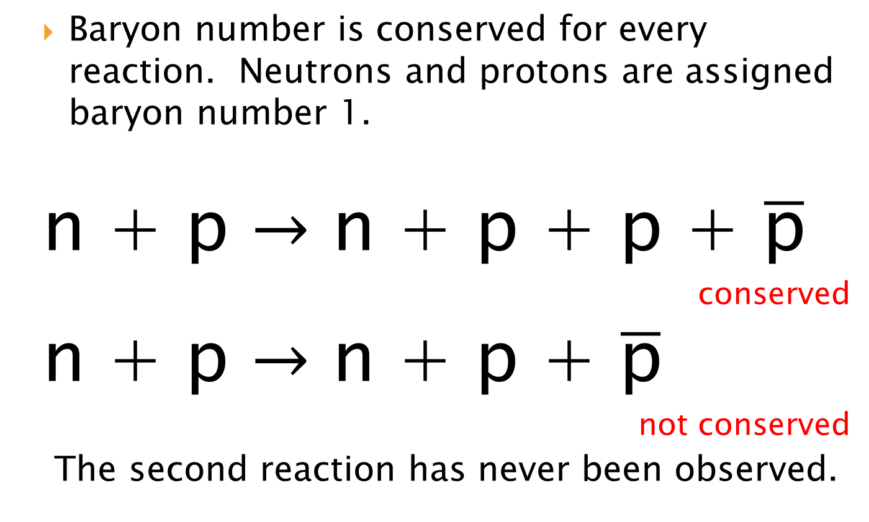
Conservation of Baryon Number
Baryon number is conserved for every reaction. Neutrons and protons are assigned baryon number 1.
n + p $→$ n + p + p + $\overline{\text{p}}$
conserved
n + p $→$ n + p + $\overline{\text{p}}$
not conserved
The second reaction has never been observed.

Slide 33
Strangeness
Strange particles are produced copiously but decay relatively slowly.
Strangeness is conserved in the strong interaction, but not in the weak interaction

Slide 34
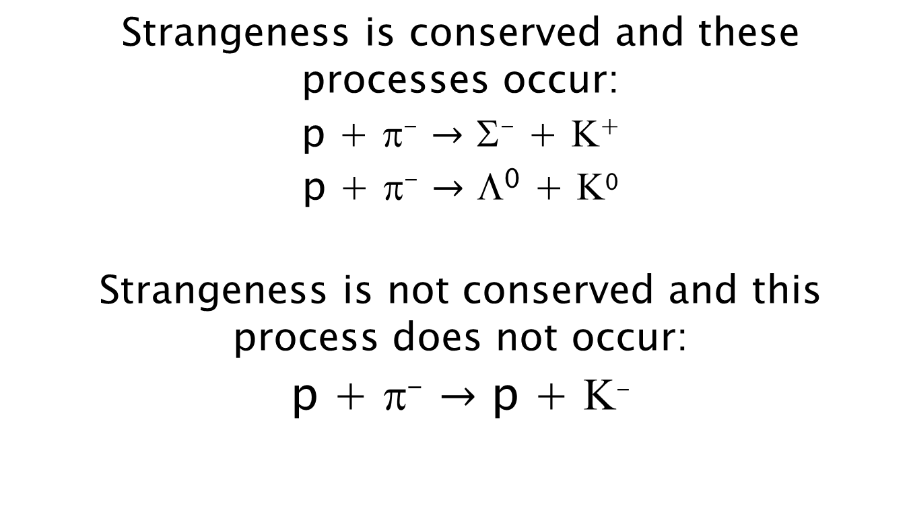
Strange Examples
Strangeness is conserved and these processes occur:
p + π⁻ $→$ Σ⁻ + Κ⁺
p + π⁻ $→$ Λ⁰ + Κ⁰
Strangeness is not conserved and this process does not occur:
p + π⁻ $→$ p + Κ⁻

Slide 35

More Strange Examples
Strangeness is not conserved in these decays:
Σ⁻ $→$ n + π⁺
Λ⁰ $→$ p + π⁻
Κ⁻ $→$ π⁺+ π⁻+ π⁻
Yet, these do occur.

Slide 36
Conservation Laws
Conserved in all interactions: energy, momentum, angular momentum, and electric charge.
Conserved in all interactions: baryon number and the three lepton numbers.
Conserved in all strong and electromagnetic interactions and some weak ones: strangeness.
Conserved in all strong interactions: isospin
Conserved in all strong and electromagnetic interactions: parity

Slide 37
Quarks
Hadrons are not fundamental particles rather they are comprised of smaller particles called quarks.
That neutrons have magnetic moment was the first indication that hadrons are composite particles.
It was originally believed that the smallest unit of electric charge was that of an electron. Quarks come with charges of magnitude +2/3e and 1/3e.
Quarks come in six flavors-up, down, strange, charm, top, and bottom- and three colors-red, green, and blue.

Slide 38
A Table of Quarks
Symbol | Q/e | Spin | Baryon Number | Strangeness | Charm | Bottomness | Topness
u | 2/3 | 1/2 | 1/3 | 0 | 0 | 0 | 0
d | -1/3 | 1/2 | 1/3 | 0 | 0 | 0 | 0
s | -1/3 | 1/2 | 1/3 | -1 | 0 | 0 | 0
c | 2/3 | 1/2 | 1/3 | 0 | +1 | 0 | 0
b | -1/3 | 1/2 | 1/3 | 0 | 0 | +1 | 0
t | 2/3 | 1/2 | 1/3 | 0 | 0 | 0 | +1

Slide 39
The Quark Model
Every baryon is composed of three quarks and every antibaryon is composed of three antiquarks.
Every meson is composed of one quark and one antiquark.

Slide 40
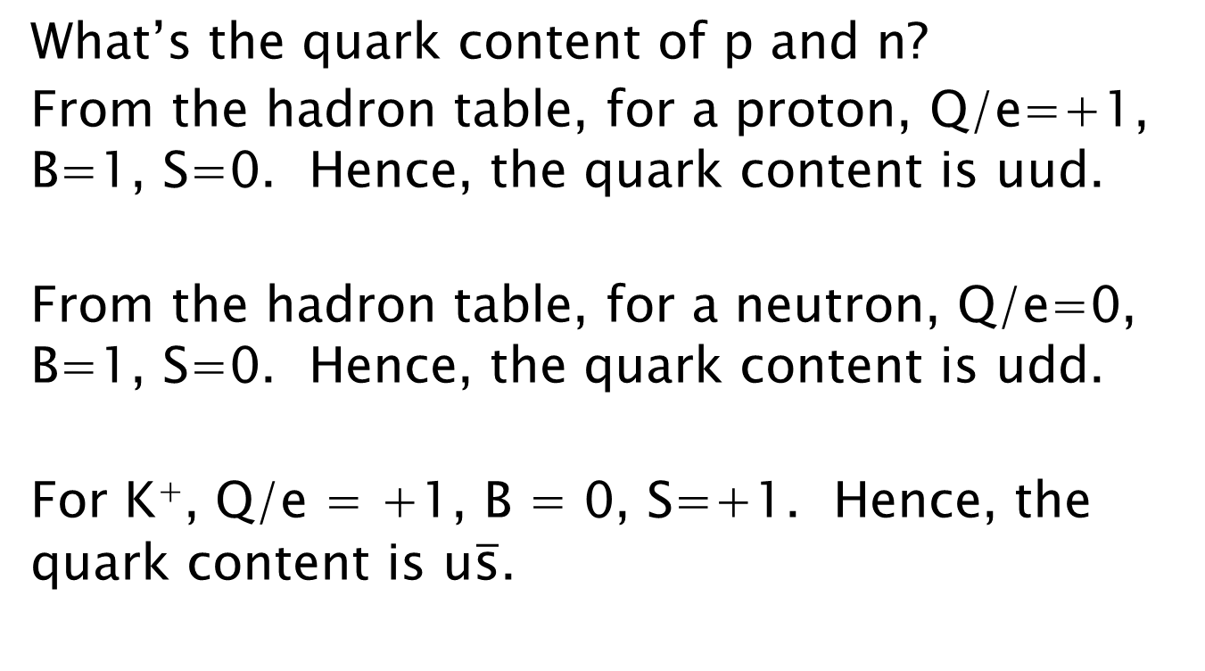
Determining the Quark Content
What’s the quark content of p and n?
From the hadron table, for a proton, Q/e=+1, B=1, S=0. Hence, the quark content is uud.
From the hadron table, for a neutron, Q/e=0, B=1, S=0. Hence, the quark content is udd.
For K⁺, Q/e = +1, B = 0, S=+1. Hence, the quark content is u$\overline{\text{s}}$.

Slide 41
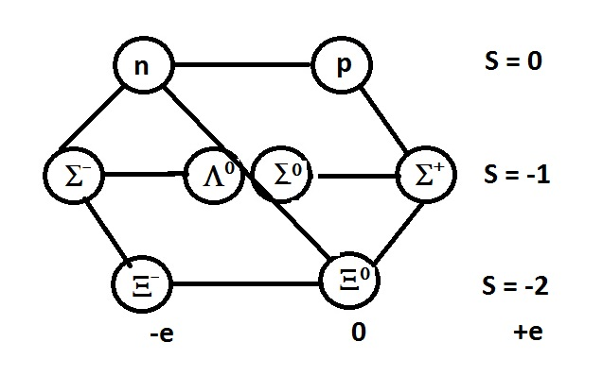
The Eightfold Way
The eightfold way is a reference to the symmetries in charge and strangeness.

Slide 42
The Standard Model
All matter is composed of leptons, quarks, and mediators.
The electroweak theory is the name for the unified electromagnetic and weak forces.
At low energies, these forces behave differently on account of the difference in the masses of their mediators. At high energies, this difference disappears. The masses of the mediator particles, W^{+,_} and Z⁰, were correctly predicted by this theory.
The last piece to this model is the Higgs boson, which researchers at CERN believe they have found.

Slide 43
Beyond the Standard Model
Scientists know that the Standard Model is not the final word.
The Standard Model predicts massless neutrinos, yet experiments have demonstrated that they do carry mass.
The Standard Model does not explain dark matter or what happened to antimatter after the Big Bang.

